Slide 1
Performance Calculation and Weight Estimation
Presented by Ritwik

Slide 2

Validation of BEMT performance
We use Harrington rotor experimental results to validate our BEMT performance (in hover mode)
Although that data is for co-axial rotors, we will only take single rotor results
Harrington has results for σ= 0.076 and Tip speed ≈ 392 ft/s so we run our code these values to plot the variation of $C_{Q}$ vs $C_{T}$

Slide 3
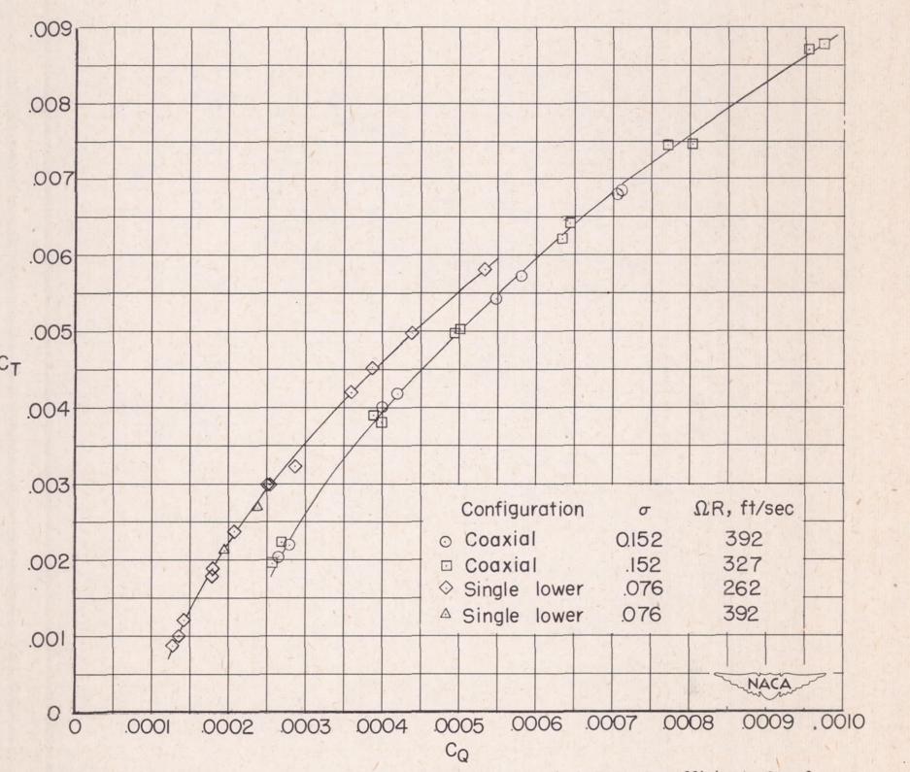
Experimental Data
Chord with no Taper
0.2 blade cutoff

Slide 4
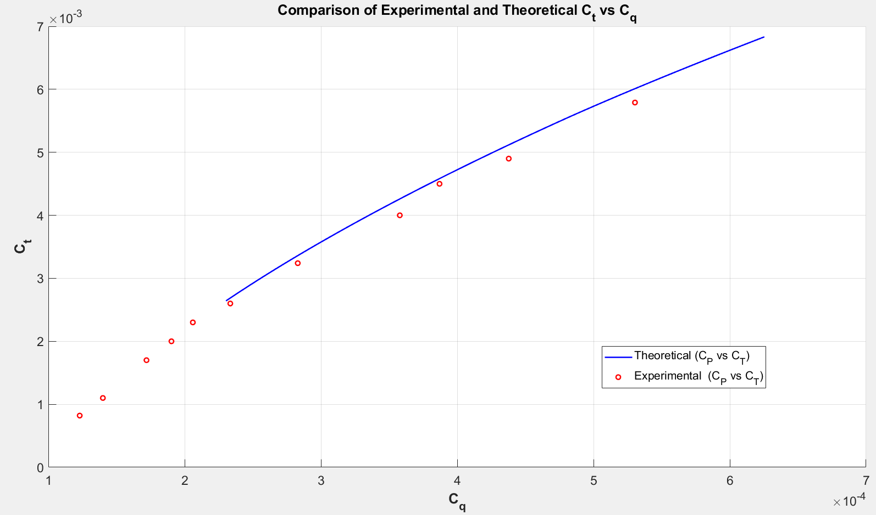

Slide 5
Parameter | Theoretical Value | Experimental Value
Solidity | 0.076 | 0.076
Tip Speed (ft/sec) | 392 | 391.9
Airfoil | NACA symmetric | NACA 0012
Radius (inch) | 150 | 150
Chord (inch) | 18 | 19.1

